Slide 1


Open Radio Access Network (5G)
Evaluation of 5G Open RAN simulation Environments.
Research Project
Professor: Dr.-Ing. Andreas Grebe
Student: Md Nur Mohammad
Master in Communication Systems and Networks

Slide 2
Agenda
Open Radio Access Network (O-ran).
O-RAN ALLIANCE community.
Logical Architecture of open RAN.
O-RAN Alliance Releases.
Component of F Release.
Ran Intelligent controller Architecture.
Near-Real-time RIC X-APPs (RICAPP).
Non-Real-time RIC (A1 & R1 Interfaces) (NONRTRIC).
Questions?

Slide 3
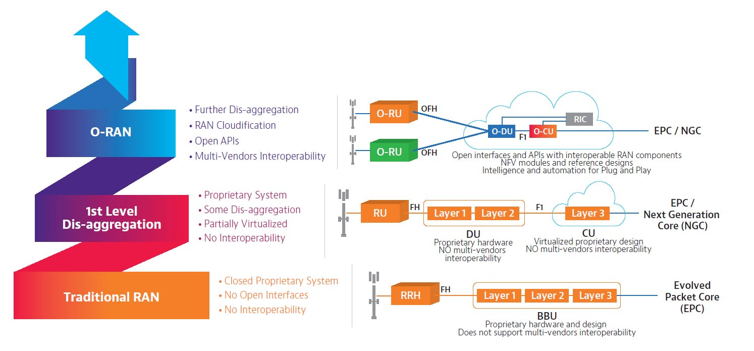
Open Radio Access Network (O-ran)

Slide 4
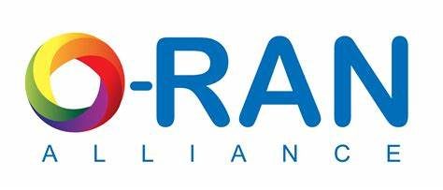
World-wide community.
Mission is to re-shape the Industry.
Supports its members in several Areas.
Website: https://www.o-ran.org/

Slide 5
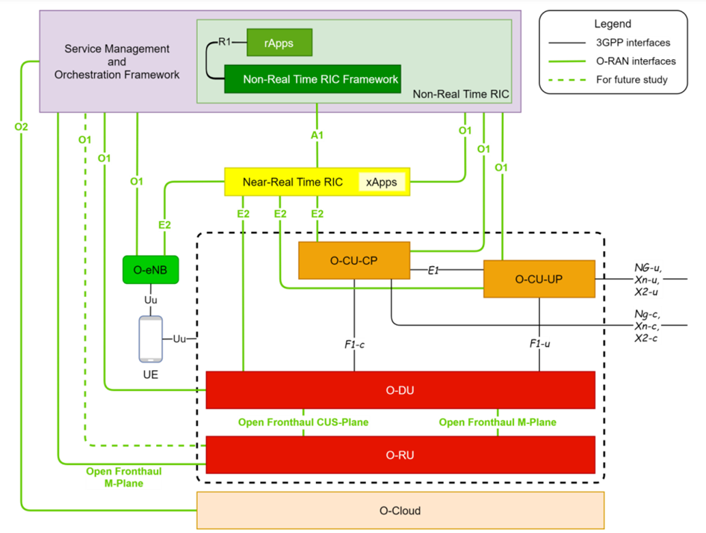
Logical Architecture of open RAN
5G Core
Network
RRC=Radio Resources Control
SDAP=Service Data Adaptation
Protocol
PDCP=Packet Data Convergence
Protocol

Slide 6
O-RAN Alliance Releases
A Release (Amber release) >>Release date: November 2019
B Release (Bronze Release) >>Release date: Jun 2020
C Release (Cherry Release) >> Release date: December 2020
D Release (Dawn Release) >>Release date: July 2021
E Release (Emerald Release) >>Release date: December 2021
F Release >>Release date: July 2022
G Release>> Release date: December 2022
H Release (Upcoming)

Slide 7
F Release
Near-Real-time RIC X-APPs (RICAPP) (E2 interface) (100%)
Non-Real-time RIC (A1 & R1 Interfaces) (NONRTRIC) (100%)
Operation and Maintenance (OAM) (50%+)
O-RAN Central Unit (OCU)
O-DU High
O-DU Low
Simulators (SIM)
Infrastructure (INF)
Documentation (DOC)
Service Management and Orchestration
Web link: https://wiki.o-ran-sc.org/display/REL/F+Release

Slide 8
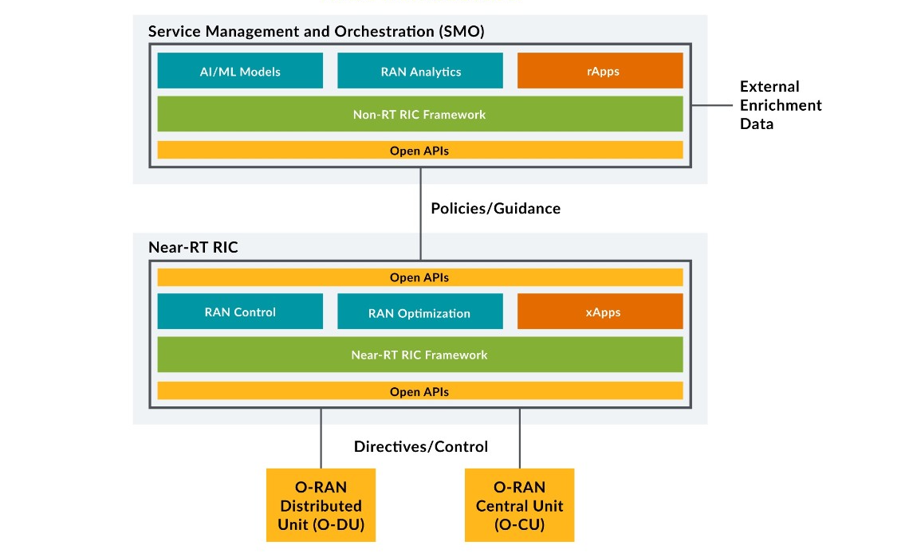
Ran Intelligent Controller Architecture

Slide 9
Near-Real-time RIC X-APPs (RICAPP) (E2 interface)
Requirements
Linux(Ubuntu 20.04)
With (Minimum 4CPU & 16GB RAM)
Kubernetes 1.16
Helm 3.9
X-APPs Frameworks
C++
Go
Python
Challenges:
The reimplementation of the A1 mediator in go-lang has proceeded but is not yet ready and not yet replacing the existing python implementation.
Default User setup fails when authentication is enabled for Influx DB.
In addition to the go x-app framework also the python x-app framework support x-app registration and x-App E2 subscriptions via REST.

Slide 10

Working on
Non-Real-time RIC (A1 & R1 Interfaces) (NONRTRIC)
Requirements
Linux(Ubuntu 20.04)
With (Minimum 8CPU & 32GB RAM)
Kubernetes 1.26
Helm 3.9
r-APPs Frameworks
C++
Java
Python
Challenges:
Create/apply K8S configurations to isolate platform services and rApp microservices, then configure controlled secure access between service.
Kubernetes cluster container run-time is not created.
Kubernetes cluster localhost error. As a result, cluster will be not created.
With nonrtric namespace container is in pending stage.
Non-RT-RIC cluster is ContainerCreating stage.

Slide 11
Questions ?

